Slide 1
Go-Back N Protocol
Computer Networks
-Ashish Gupta (2015MT10725)
-Tarun Gupta (2015MT60568)

Slide 2
What we have done?
We implemented Go Back N protocol which is a sliding window protocol. The protocol facilitates sending and receiving of data between two hosts H1 and H2 where both hosts act as senders and receivers of data and ack frames.
The working of protocol was analyzed with varying parameters such as packet drop probability, ack drop probability, transmit window size and timeout window etc.
Packet and ack frames were created as per the specifications provided in the assignment problem statement to emulate what happens in real life.

Slide 3
How we implemented the algorithm:
We used socket programming to simulate sending and receiving of data and ack frames between two hosts, H1 and H2. Two sockets corresponding to the two hosts were created and were bounded to the two addresses (ip, port).
Two threads were created, the first thread being the sender thread and the second thread was the receiver thread.
An event named “resend_packets” which when triggered results in the sender thread re-sending the packets buffered in a queue held by the sender thread. This event is triggered whenever there is a timeout in receiving an ack for a packet sent by the sender thread. After re-sending the packets, the event is cleared and the algorithm generates new packets to send.

Slide 4
How we implemented the algorithm(contd.):
The “should_drop” function simulates the error probabilities mentioned for packets and acks. A random number between 0 and 1 is generated and if the random number is less than threshold, the corresponding packet is dropped.
The packets are sent as datagrams i.e. UDP packets.
The packets are successfully received only if their sequence numbers are equal to “frame_expected”. In the other case, packet is simply discarded. Acks are considered cumulative and processed as such.
The data and ack frames need to be pickled before sending them because they can only be sent in a stringified format. They are unpickled at the receiver ends.

Slide 5
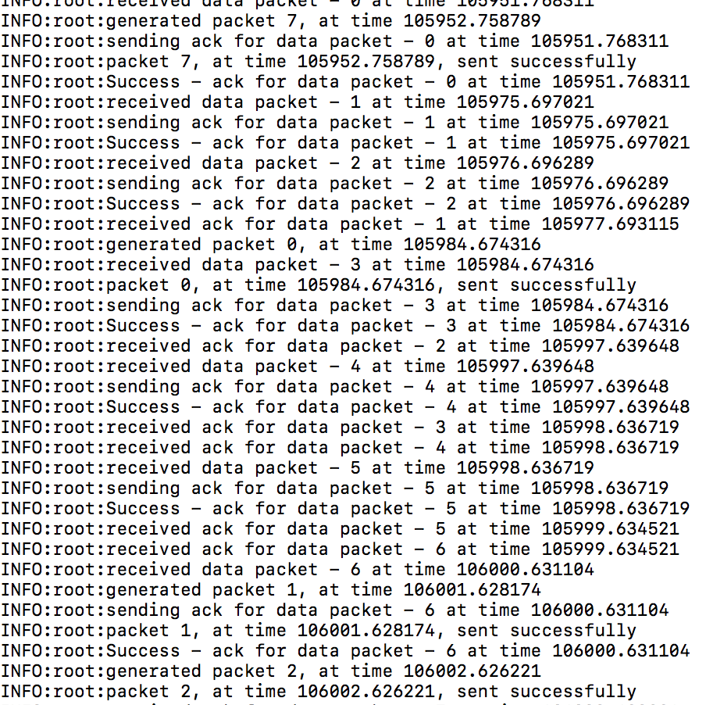
Simulation Log (No packet and Ack drop)
Complete log in the file - host1_without_error.log

Slide 6
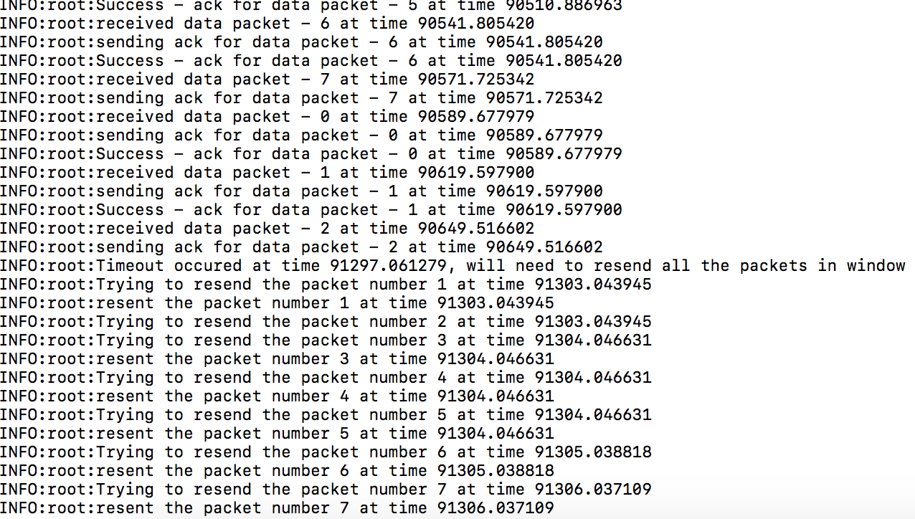
Simulation Log (Packet drop and ack drop)
Complete log in the file - host1.log

Slide 7
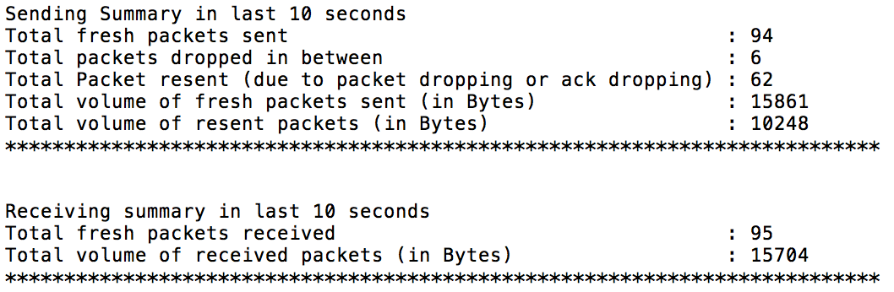
Summary of the experiments:
Packet drop probability - 0.1

Slide 8
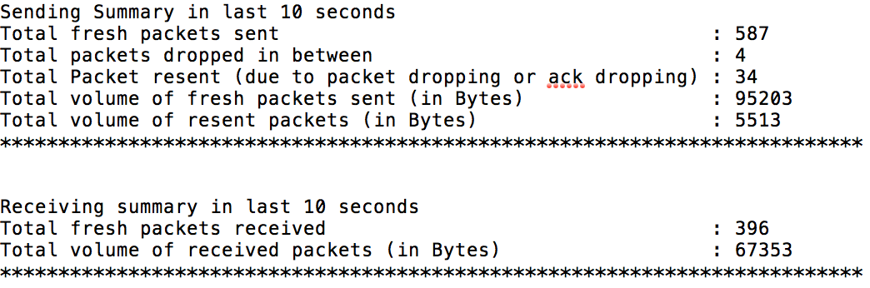
Summary of the experiments (contd):
2. Packet drop probability - 0.01

Slide 9
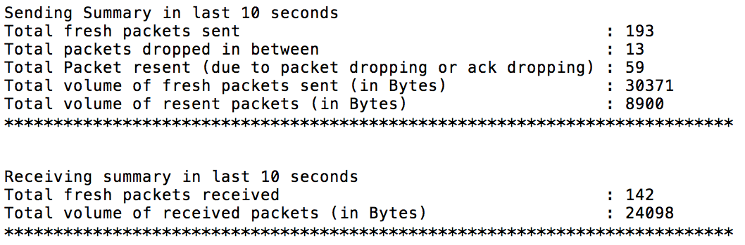
Summary of the experiments(contd.):
3. Packet drop probability - 0.05

Slide 10
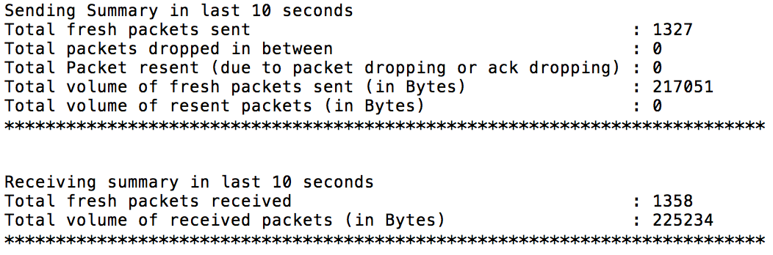
Summary of the experiments(contd.):
4. Packet drop probability - 0

Slide 11
Summary of the experiments(contd.):
1. Transmit window size-7 (Error Probability - 0.05)

Slide 12
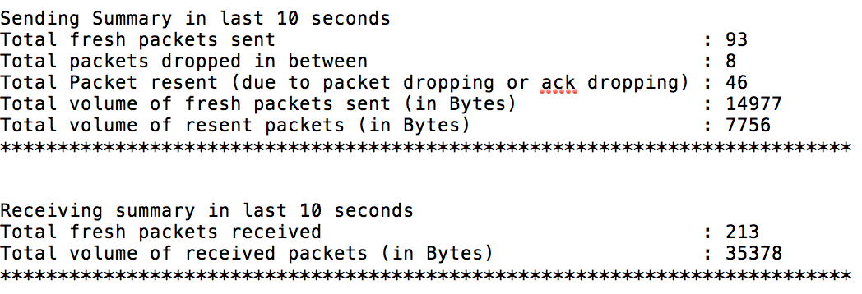
Summary of the experiments(contd.):
2. Transmit window size-5 (Error Probability - 0.05)

Slide 13

Summary of the experiments(contd.):
3. Transmit window size-9 (Error Probability 0.05)

Slide 14
Observations:
Packet drop probability | Throughput (packets/second) | Packets received/(Packets sent + packets resent)
0.1 | 9.80 | 0.52
0.05 | 14.10 | 0.56
0.01 | 47.12 | 0.87
0 | 132.25 | 0.99

Slide 15
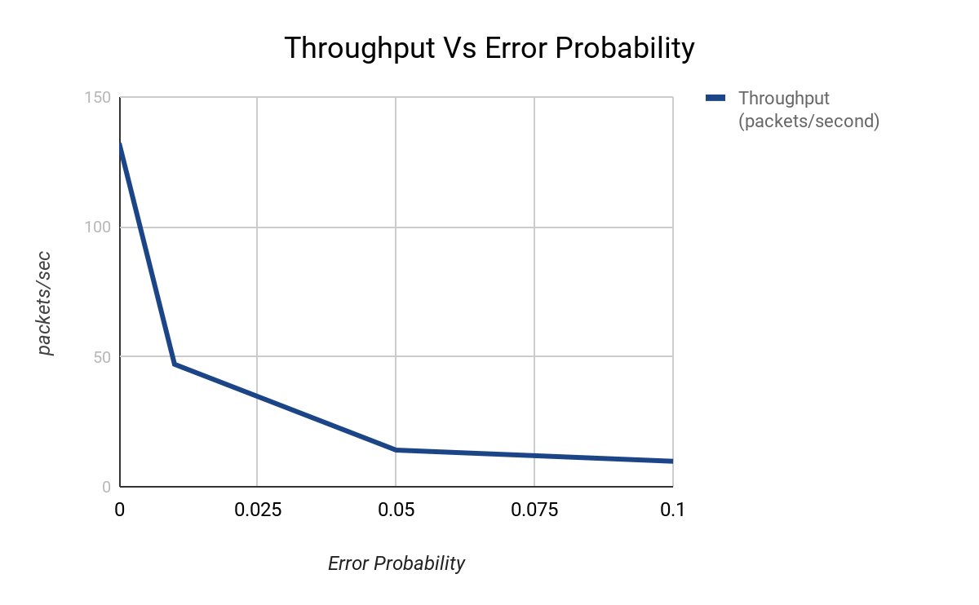
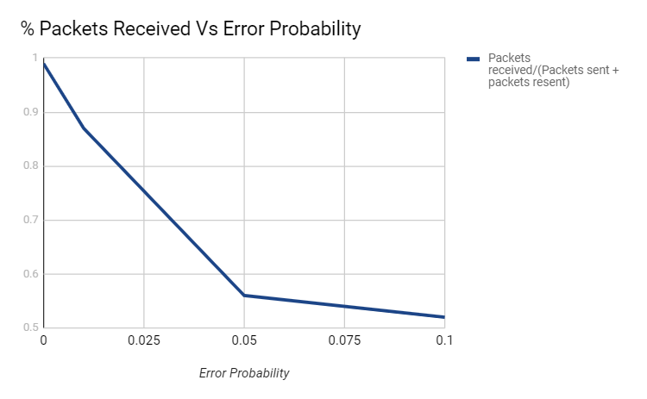
Both curves tend to zero as the error probability increases to 1

Slide 16
Conclusions:
As we increase the packet drop probability, the number of packets reaching the receiver decreases due to which the throughput decreases. Also, the ratio number of packets received to the total number of packets sent and resent decreases. The ratio is proportional to the efficiency of Go-BackN algorithm.
For error free packet transmission, almost all the packets sent are received by the receiver within the timeout window and almost zero packets need to be resent.
For packet drop probability 0.01, transmit window size 9 gave best performance in terms of throughput.
The number of packets needed to be re-sent increases with increasing drop probability as even a single packet drop leads to resending of whole window packets.
With increasing packet drop probability, the end-to-end delay increases because more number of packets need to be resent.

